Slide 1

DIGITAL MARKETING CAMPAIGN
FitLife Pro
Health & Fitness App
Campaign: #GetFitWithPro — 90-Day Digital Launch
Prepared by: Mohit verma | Batch: 2026-27 | Vellaration Technologies Pvt. Ltd.
Task 3 — Marketing Campaign Design
Notes:
Welcome slide. Introduce the campaign concept: FitLife Pro is a new fitness app targeting urban Indian millennials aged 22–35. Campaign name: #GetFitWithPro — a 90-day digital launch campaign.
1

Slide 2
Campaign Overview
About FitLife Pro
Campaign Details
Product: AI-powered health & fitness mobile app
Platform: Android & iOS
Target: Urban Indians, Age 22–35
Name: #GetFitWithPro
Duration: 90 Days (3 Months)
Budget: INR 10 Lakhs
Campaign Objectives
🎯
👥
💰
⭐
50,000+
5 Lakh+
INR 15L
4.5★
App Downloads
Social Media Reach
Revenue Target
App Store Rating
Notes:
Talk through the product briefly: FitLife Pro uses AI to create personalized workout and diet plans. The 90-day campaign with a 10 lakh budget aims to drive 50K downloads and build brand awareness among urban millennials.
2

Slide 3
Target Audience Analysis
Primary Segment
55%
Age: 22–30 yrs
Working professionals, gym-curious millennials, fitness beginners
Secondary Segment
30%
Age: 30–40 yrs
Health-conscious parents, weight management seekers, working moms/dads
Tertiary Segment
15%
Age: 18–22 yrs
College students, sports enthusiasts, social fitness sharers
Key Demographics: 70% metro cities | 60% Android users | Income: INR 4–15 LPA | 65% gym-goers
Notes:
Emphasize that the primary segment — urban professionals aged 22–30 — are already spending on fitness but lack consistency. FitLife Pro solves this with AI-guided plans and habit tracking.
3

Slide 4
Social Media Plan
Instagram
2 posts/day
35%
Twitter/X
3–4 tweets/day
10%
Type: Reels, Stories, Carousels
Type: Threads, Polls, Memes
Workout tips, transformation posts, influencer collabs
Health facts, motivational threads, trending hashtags
YouTube
3 videos/week
25%
WhatsApp
Daily broadcasts
10%
Type: Long-form + Shorts
Type: Status, Groups
Full workout sessions, nutrition guides, success stories
Daily workout reminders, exclusive subscriber tips
Facebook
1 post/day
20%
Type: Posts, Groups, Events
Community building, retargeting ads, event promotions
Notes:
Instagram is the primary platform given the visual nature of fitness content. YouTube drives deeper engagement. WhatsApp for retention and community building. Total posting cadence: ~45 pieces of content per week across all platforms.
4

Slide 5
Content Strategy & Ideas
🎬 Video Content
📸 Static Posts
• 30-day challenge reels (daily)
• Behind-the-scenes app walkthrough
• User transformation stories (UGC)
• Workout tip infographics
• Nutrition myth-busting carousels
• Quote + motivational graphics
🎙️ Interactive
🤝 Influencer Content
• Weekly Q&A stories on Instagram
• Twitter fitness polls & threads
• YouTube live workout sessions
• Micro-influencer (50K–500K) reviews
• Celebrity fitness challenge collabs
• Fitness blogger app tutorials
Notes:
Content pillar strategy: 40% educational (tips, myths, nutrition), 30% entertainment (challenges, reels), 20% UGC and community, 10% promotional. This ratio maximizes organic reach while keeping the audience engaged.
5

Slide 6
Ad Strategy
Phase 1 — Awareness (Month 1)
• Instagram & Facebook video ads (15–30 sec) — Reach 5 lakh users
• YouTube pre-roll ads on fitness channels — 1M+ impressions
• Influencer seeding: 10 micro-influencers × 1 post each
Phase 2 — Consideration (Month 2)
• Google App Install Campaigns — target high-intent fitness keywords
• Retargeting: website/app store visitors via Meta Pixel
• Instagram carousel ads showcasing app features & benefits
Phase 3 — Conversion (Month 3)
• Dynamic retargeting: abandoned installs & free trial users
• Referral ads: 'Invite a friend, get 1 month free' campaign
• Flash sale ads: 50% off premium subscription (limited time)
Notes:
Three-phase funnel: Awareness → Consideration → Conversion. Each phase uses different ad formats and objectives. Key metric for Phase 1: CPM and reach. Phase 2: CTR and app installs. Phase 3: CAC and conversion rate.
6

Slide 7
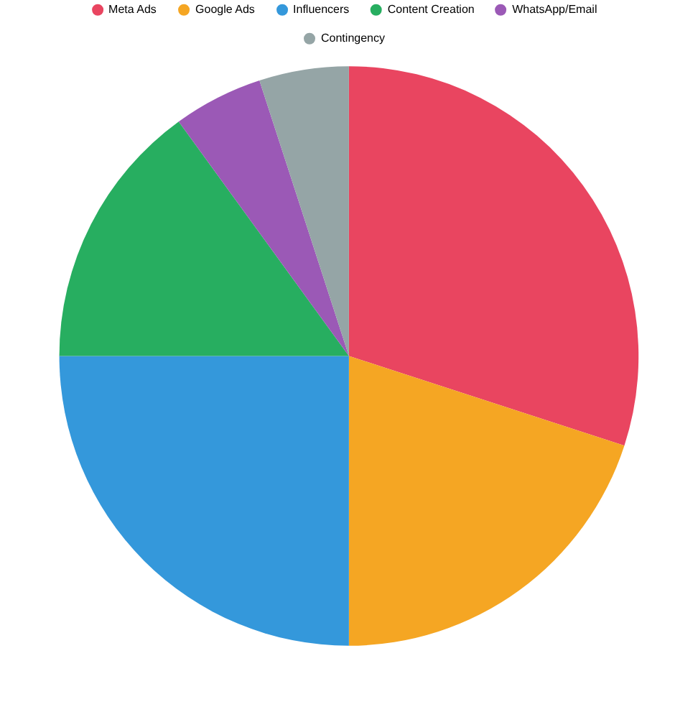
Budget Estimation
Total Budget
INR 10 Lakhs
Channel | Allocation | Amount (INR)
Meta Ads (FB+IG) | 30% | 3,00,000
Influencer Marketing | 25% | 2,50,000
Google App Campaigns | 20% | 2,00,000
Content Creation | 15% | 1,50,000
Email & WhatsApp | 5% | 50,000
Contingency | 5% | 50,000
TOTAL | 100% | 10,00,000
Notes:
Meta ads get the highest allocation because Instagram and Facebook have the most precise targeting for our audience. Influencer marketing second — critical for trust-building in the fitness space. Monitor CPM and CAC weekly.
7

Slide 8
Influencer Marketing Plan
Mega (1M+)
Count: 1
Budget: INR 80,000
Deliverables: 1 dedicated reel + 3 stories + logo on bio
Macro (100K–1M)
Count: 3
Budget: INR 30,000 each
Deliverables: 1 reel + 2 stories + app review post
Micro (10K–100K)
Count: 10
Budget: INR 7,000 each
Deliverables: 1 reel + 1 story + link in bio (7 days)
Nano (<10K)
Count: 20
Budget: Free premium plan
Deliverables: 1 honest review post + app tag in stories
Total Influencer Budget: INR 2,50,000 | Estimated Combined Reach: 15–20 Lakh users | Tracking via unique referral codes per influencer
Notes:
Micro-influencers offer the best ROI for fitness apps — their audiences are highly engaged and trust their recommendations. Use unique promo codes (e.g., FITLIFE-PRIYA) per influencer for attribution tracking.
8

Slide 9
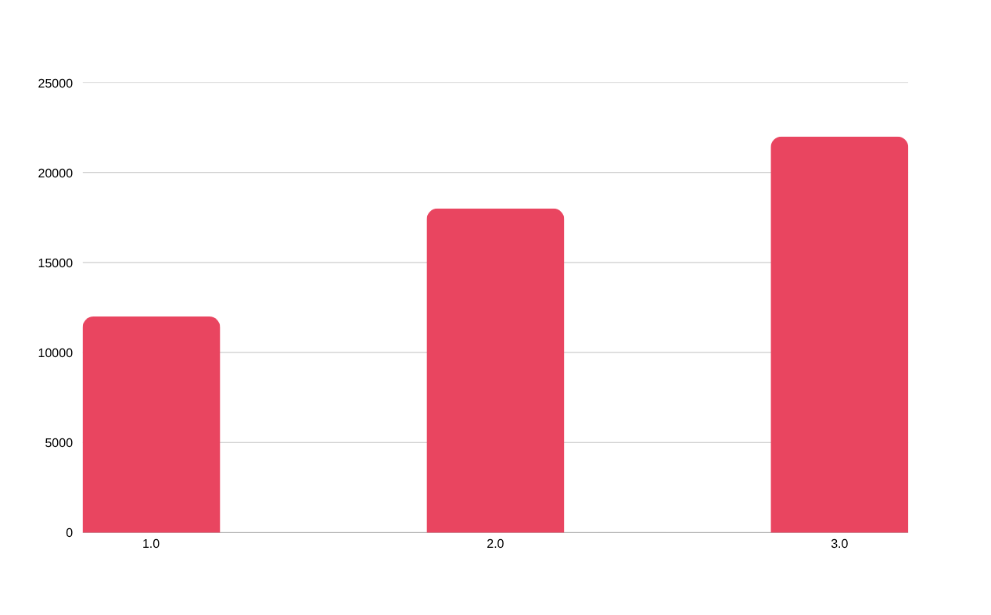
Expected Outcomes & KPIs
Total Downloads
52,000+
Social Media Reach
5 Lakh+
Avg. CAC
INR 19
Conversion Rate
4.2%
Funnel: 5 Lakh Reach → 50,000 App Store Visits → 15,000 Free Trials → 3,500 Paid Conversions → INR 14L Revenue
Notes:
The conversion funnel: from 5 lakh impressions, we expect ~10% to visit the app store, ~30% of those to download, ~25% to start a free trial, and ~23% of trials to convert to paid. CAC of INR 19 is well below the LTV of INR 600+.
9

Slide 10
Campaign Timeline & Key Milestones
Month 1
Brand seeding, influencer onboarding, awareness ads, app store optimization, social media page setup
LAUNCH
Month 2
Conversion campaigns, referral program launch, Google App Install ads, #GetFitWithPro challenge viral push
GROW
Month 3
Retargeting inactive users, flash sale, premium conversion push, UGC contest, campaign performance review
SCALE
#GetFitWithPro — Prepared by Karan Kumar | Vellaration Technologies | Batch 2026-27
Notes:
Closing slide. Recap: 90-day campaign, INR 10L budget, 3-phase approach. Month 1 sets brand awareness, Month 2 drives downloads, Month 3 converts free users to paid. Total target: 52,000 downloads and INR 14L revenue.
10

